Slide 1
Object Detection
With Duckybot19
Sohaib Salman
Ashmal Ahmed
Sabeeh Ur Rehman Sulehri

Slide 2
Introduction
A duckybot is to some extent a simulation of a car system moving through a city. We applied object detection through the duckiebot’s camera to recognize the objects in and around its path.

Slide 3
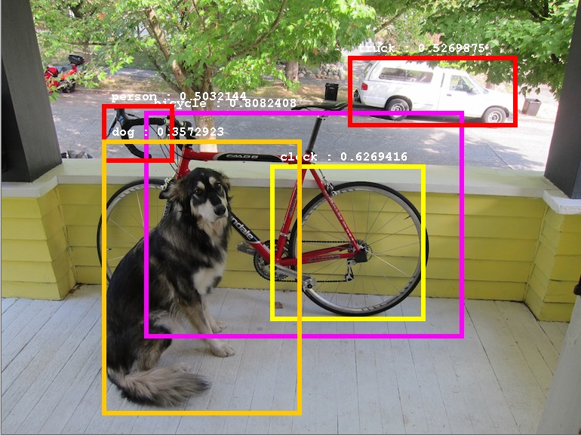
Object Detection
Object detection is a part of computer vision that consists of locating and identifying objects in an image, video or live feed. It uses spatial positions, and object localization to detect objects.
Our model of object detection will detect ducks, duckiebots, signals and stop signs.

Slide 4
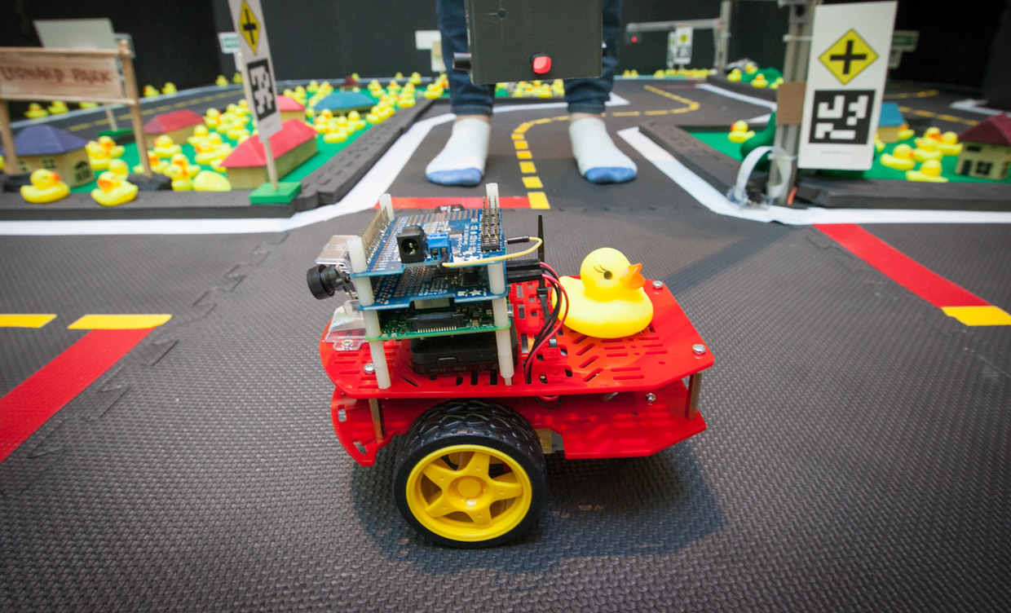
Object Detection
We used a duckybot with a camera mounted on the front which can recognize 3d objects with high accuracy.
For the environment we used duckietown which is a simulation environment consisting of signs and roads and objects.

Slide 5
Steps
Dataset collection
Dataset annotation and generation
Model training
Publisher nodes, python & .yaml files
Results

Slide 6
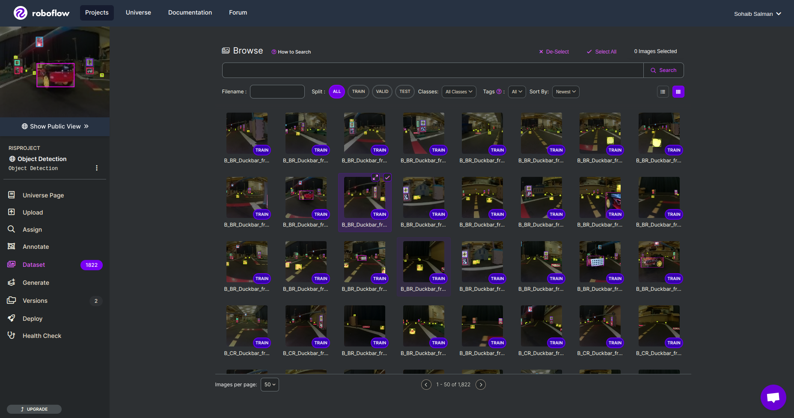
Preparing Training Data
We collected a large number of images from our duckiebot and online logs that we annotated using Roboflow.
We divided the images into Train, Valid and Test.
After some pre processing and augmentation steps, the dataset was generated.

Slide 7
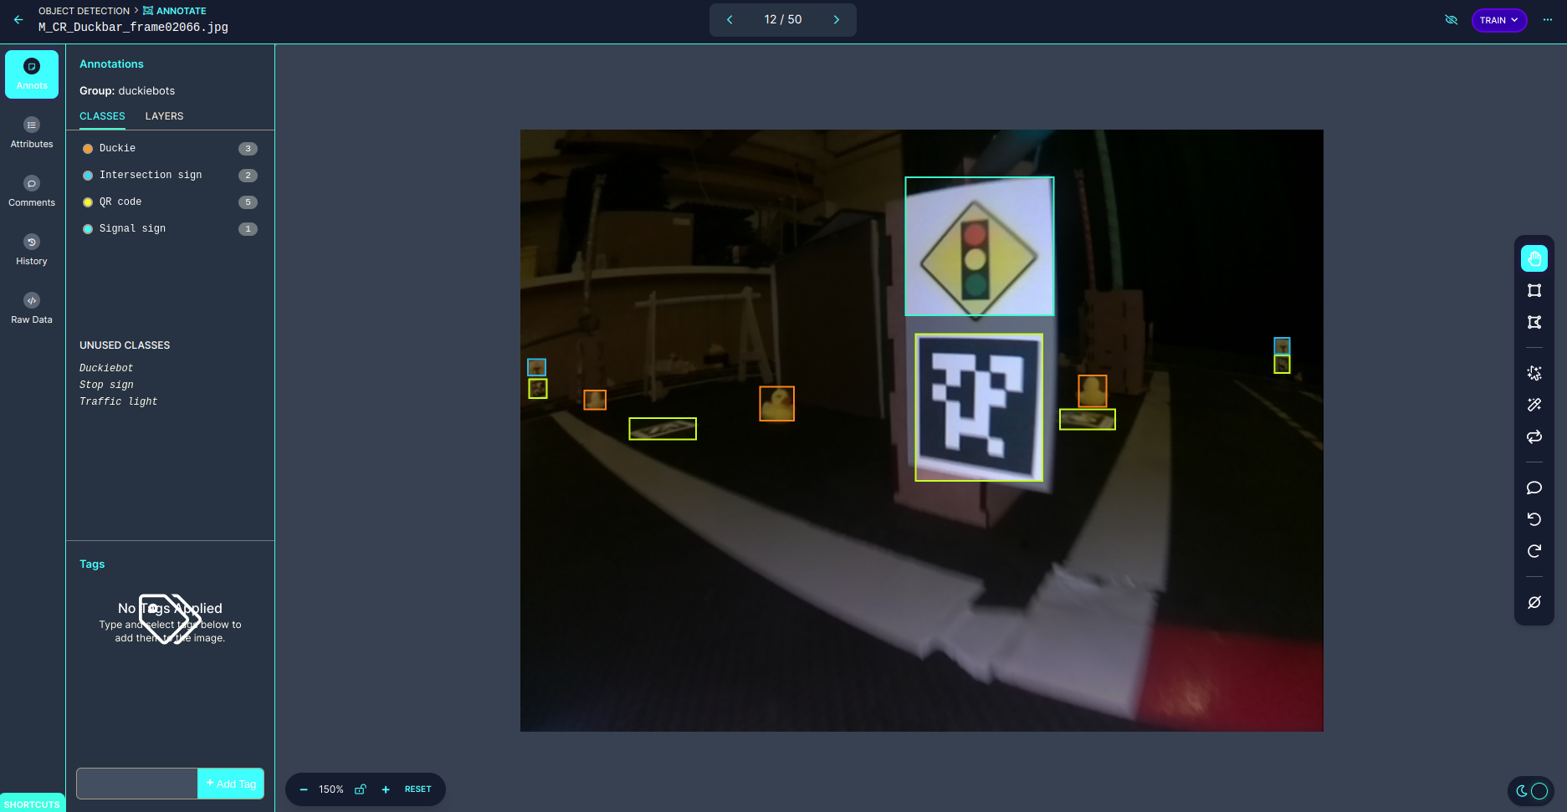
Preparing Training Data

Slide 8
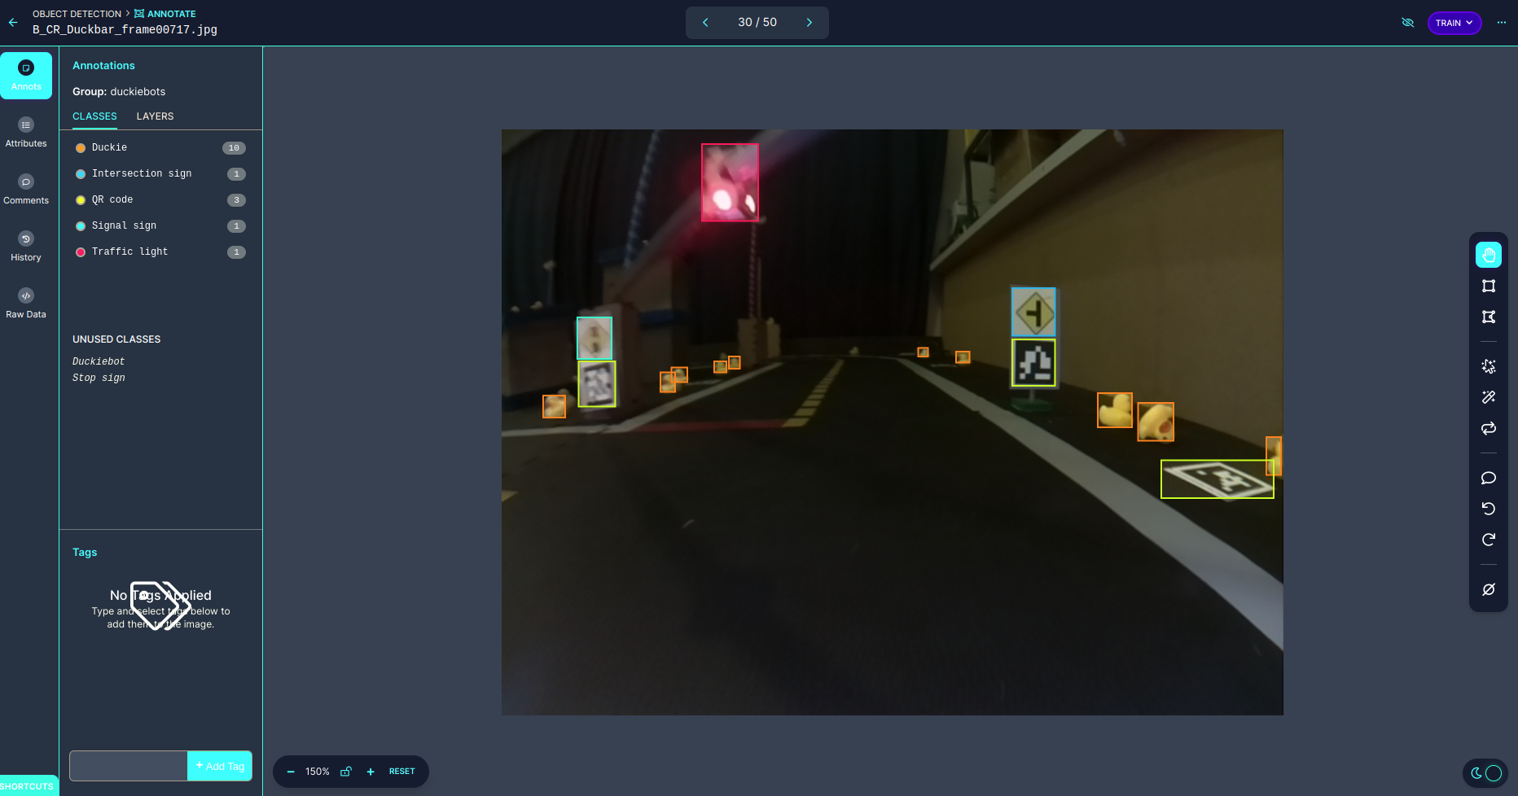
Preparing Training Data

Slide 9
Training the Model
For our object detection we used Yolov5. Yolov5 is an object detection architecture and network which performs the task by dividing the input image into a grid and predicting bounding boxes and class probabilities from the grid for each component.
We trained the model using our generated annotated dataset from Roboflow with the right batch size. Then we used the output weights with the publisher.py to subscribe to camera feed to detect objects.

Slide 10
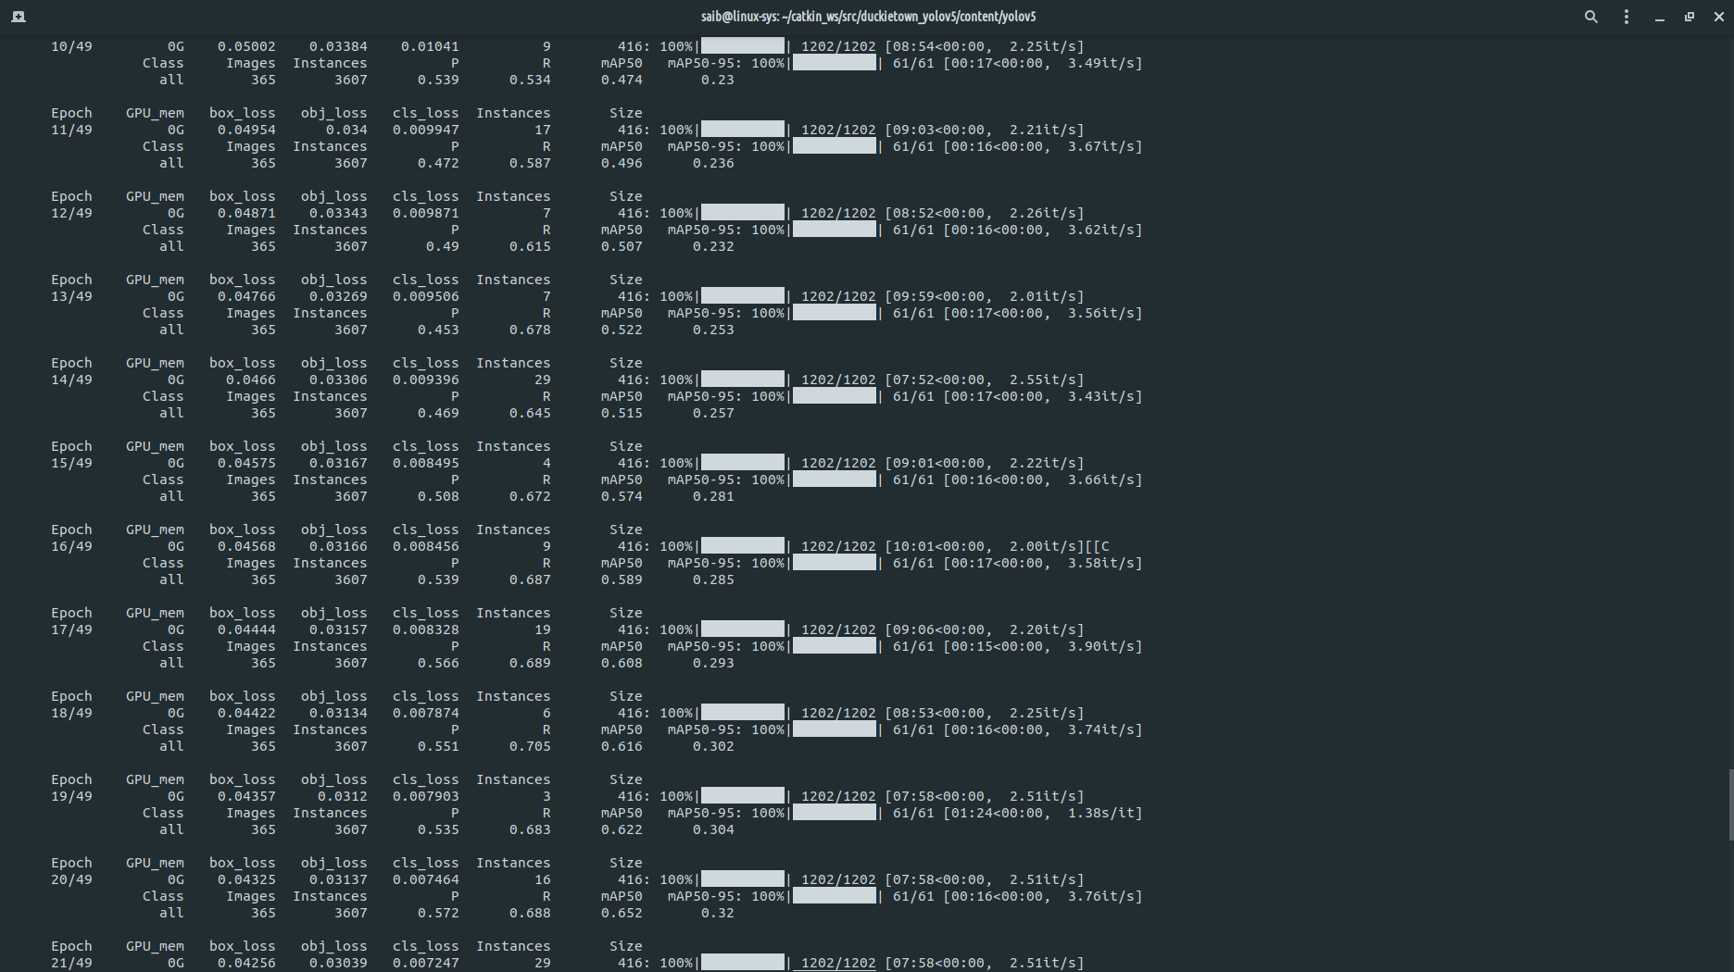
Training the Model

Slide 11
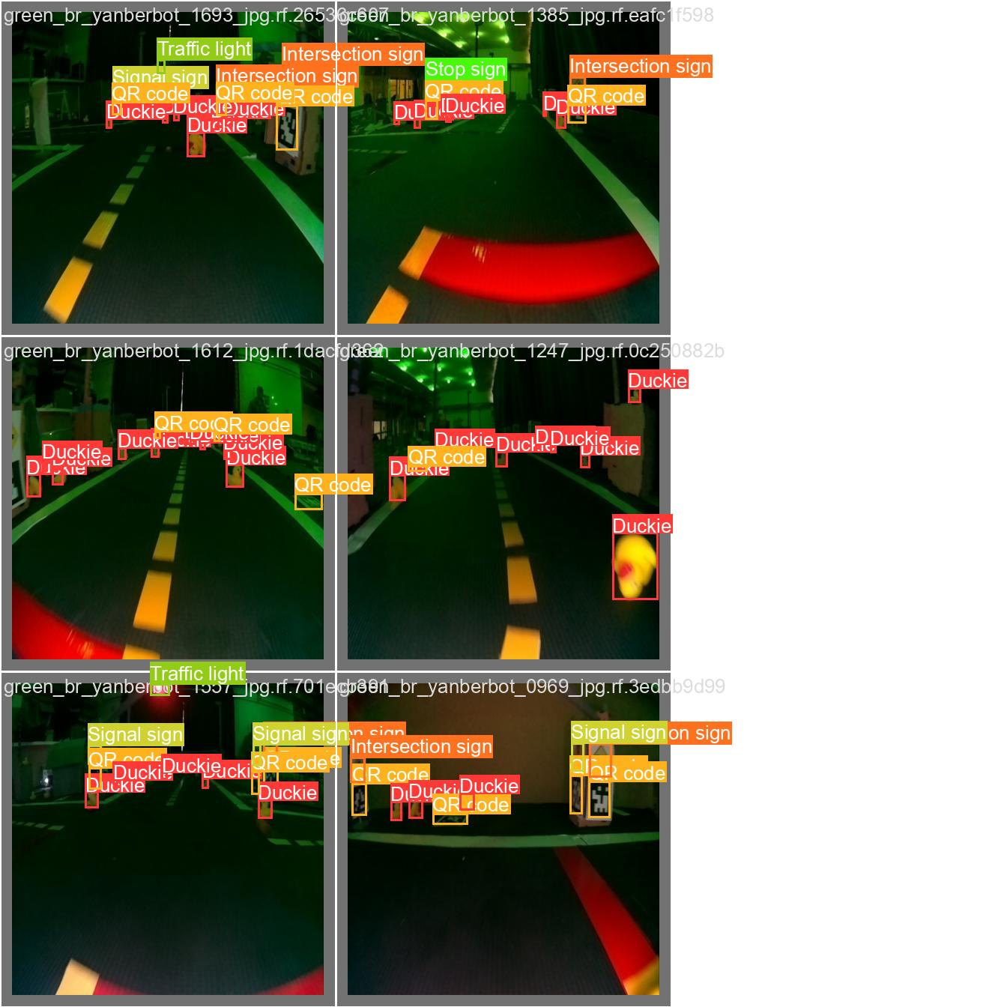
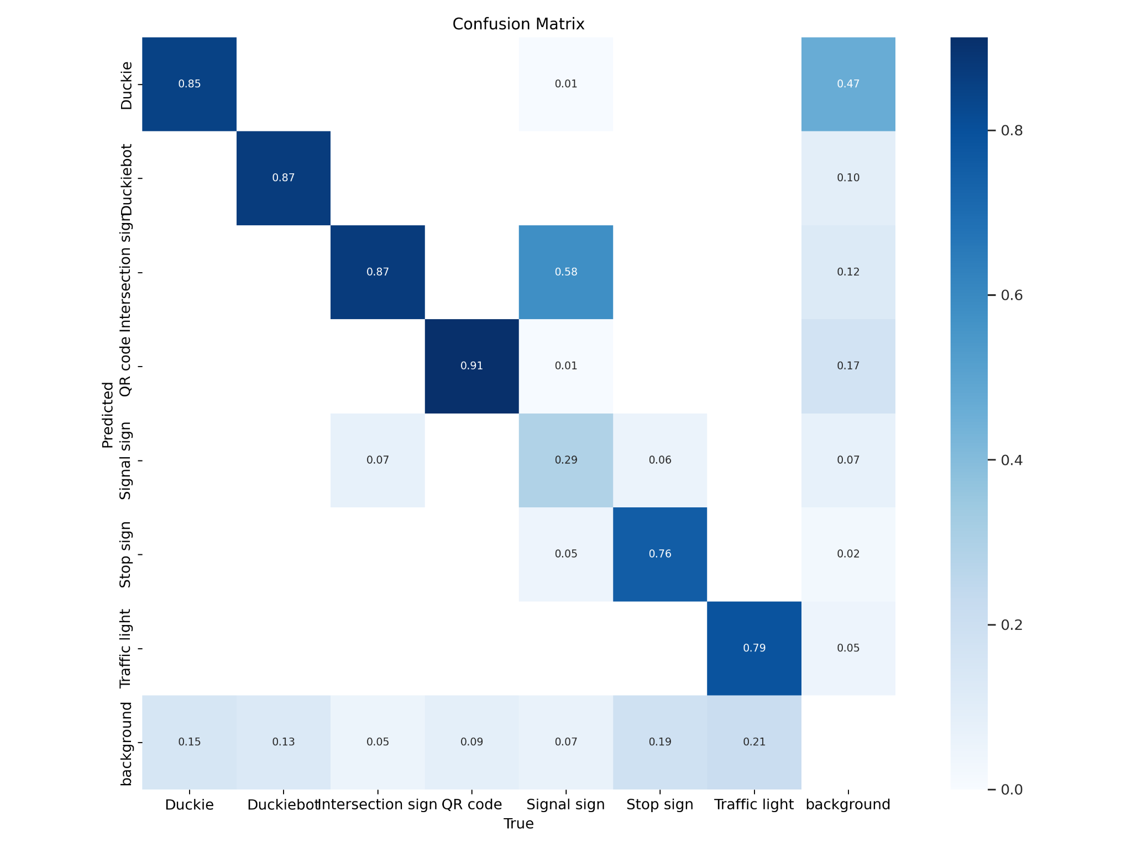
Training the Model

Slide 12
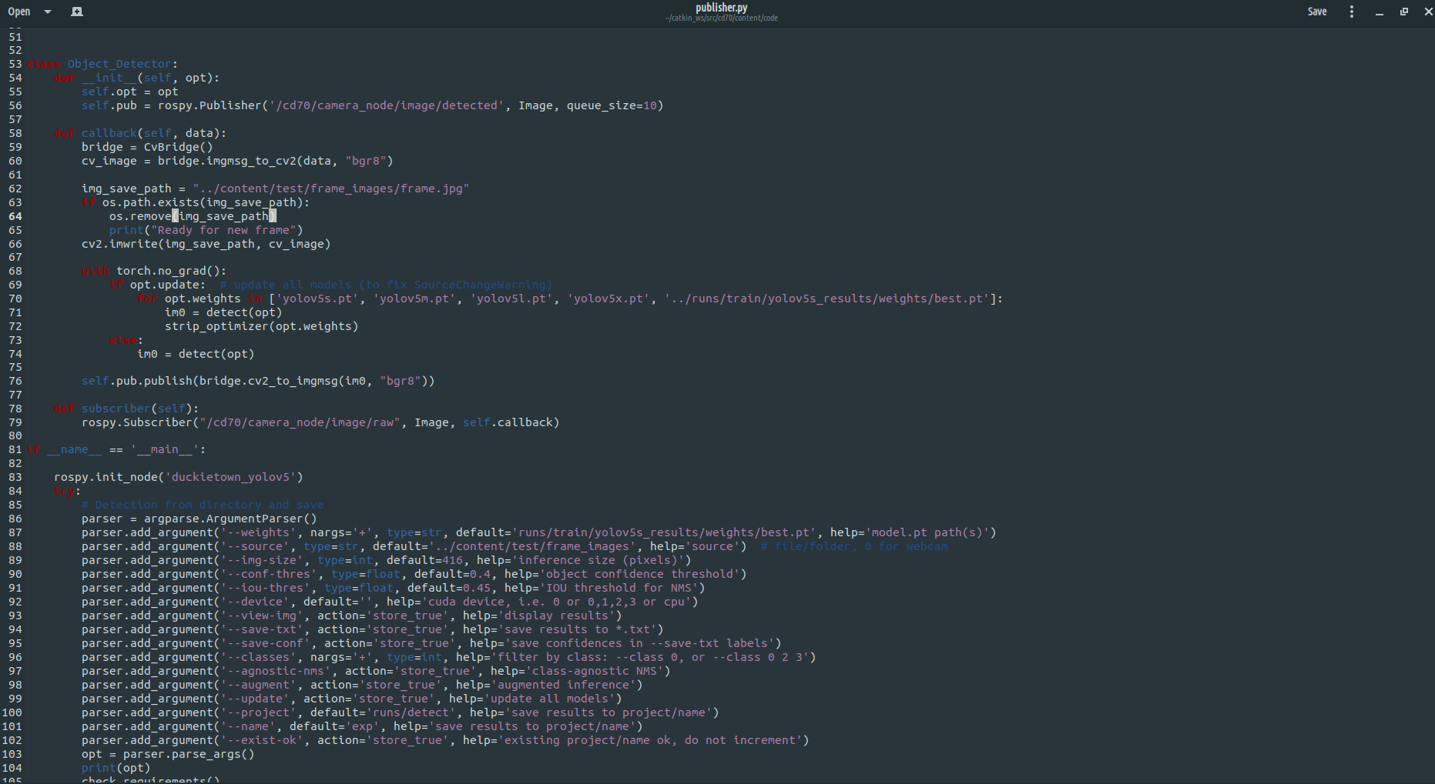
Files

Slide 13
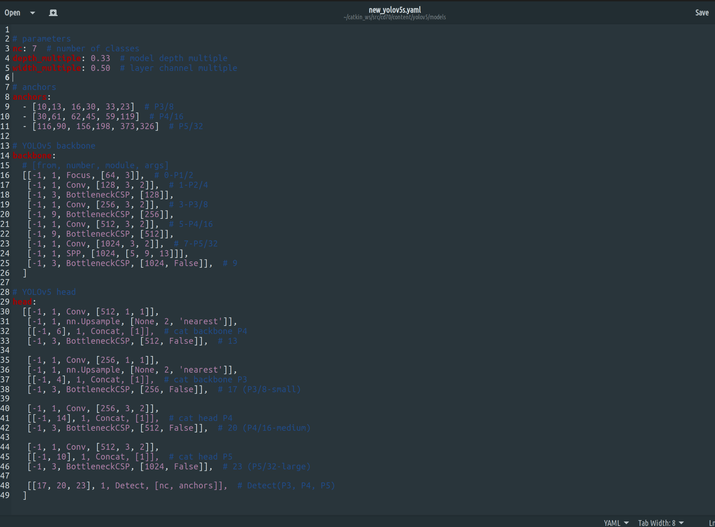
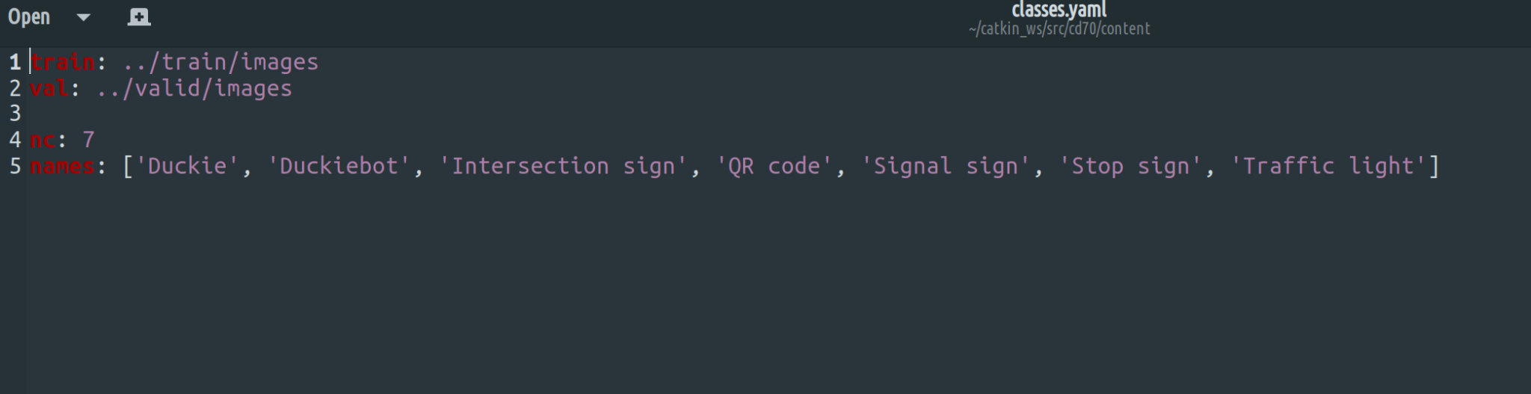
Files

Slide 14
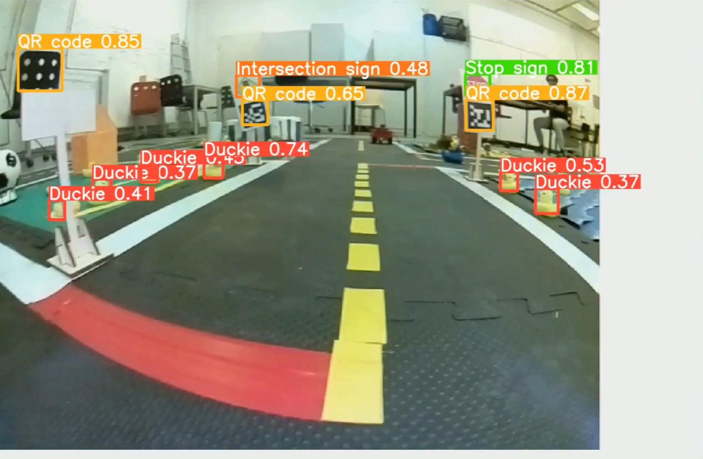
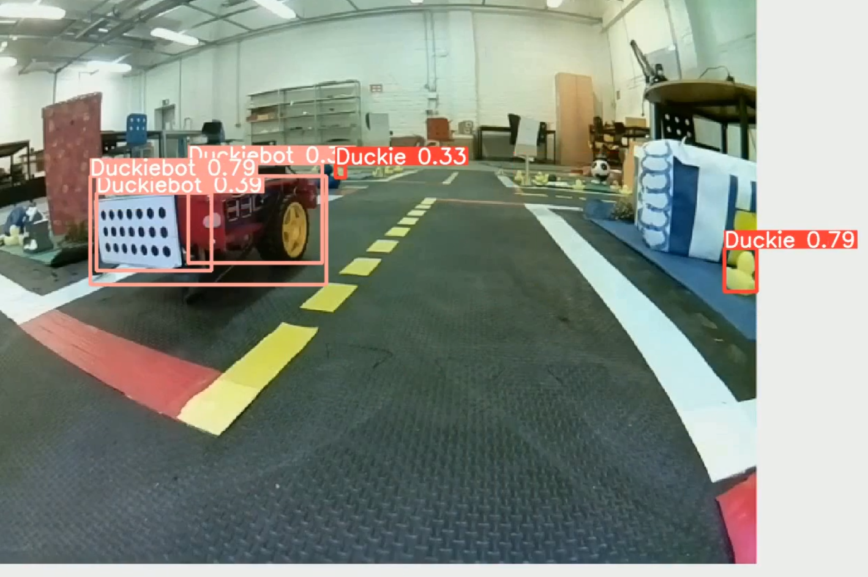
Output

Slide 15
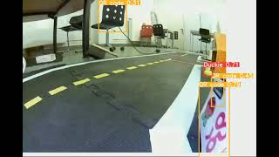
Output

